Slide 1

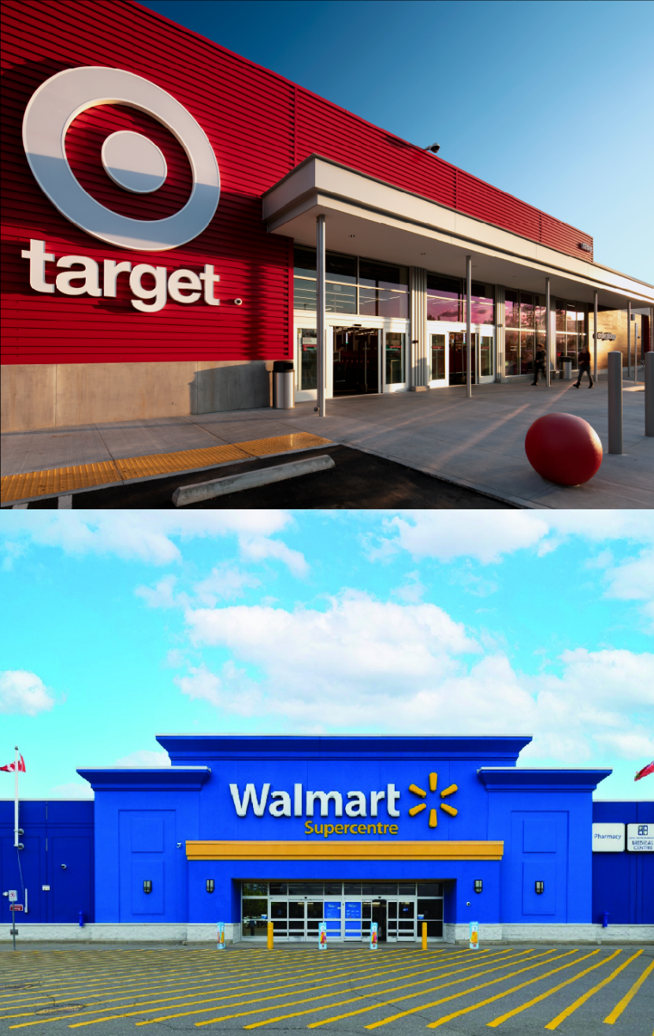
Analyzing Crime Patterns Around Walmart and Target
Sal Figueroa: GEOG -120

Slide 2
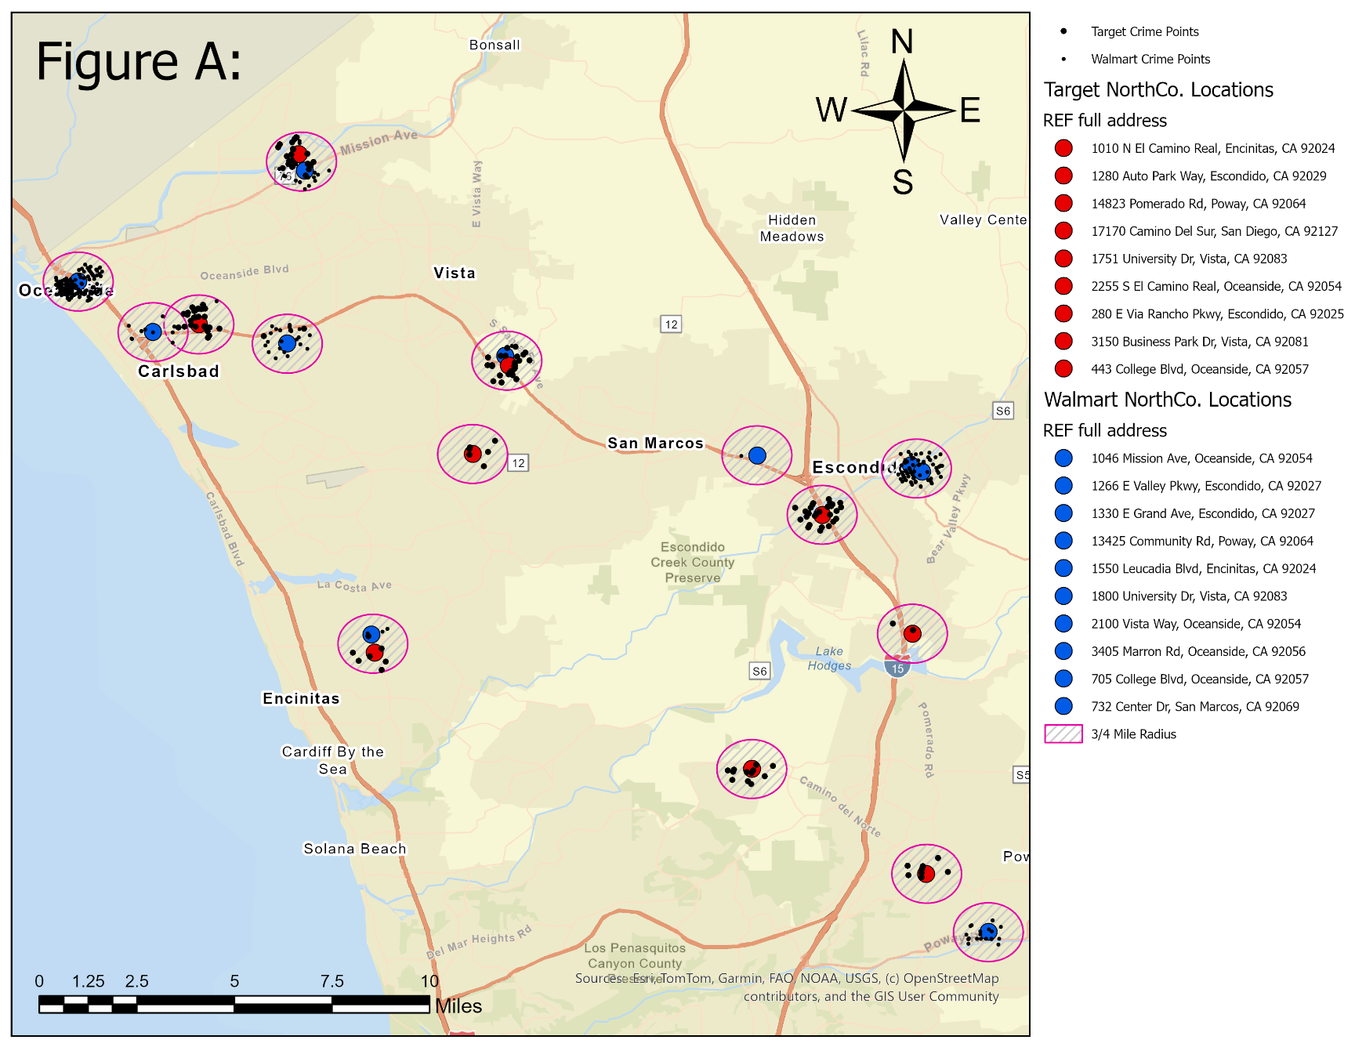
So Where Does the North County San Diego Start and end?
What are the parameters of this simple crime study between retail stores?
What’s the radius and time frame of interest for each location?
How to account for locations that are within the crime radius of another location.

Slide 3
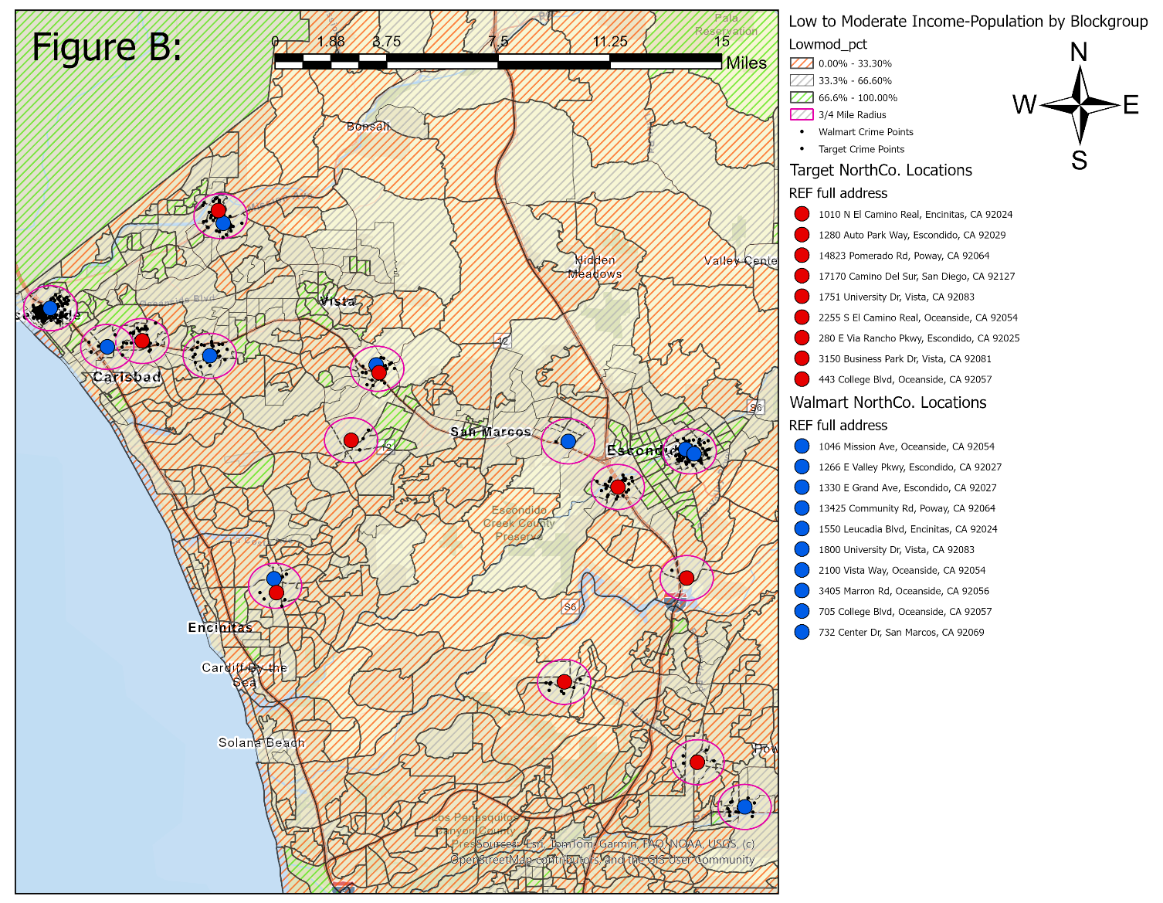
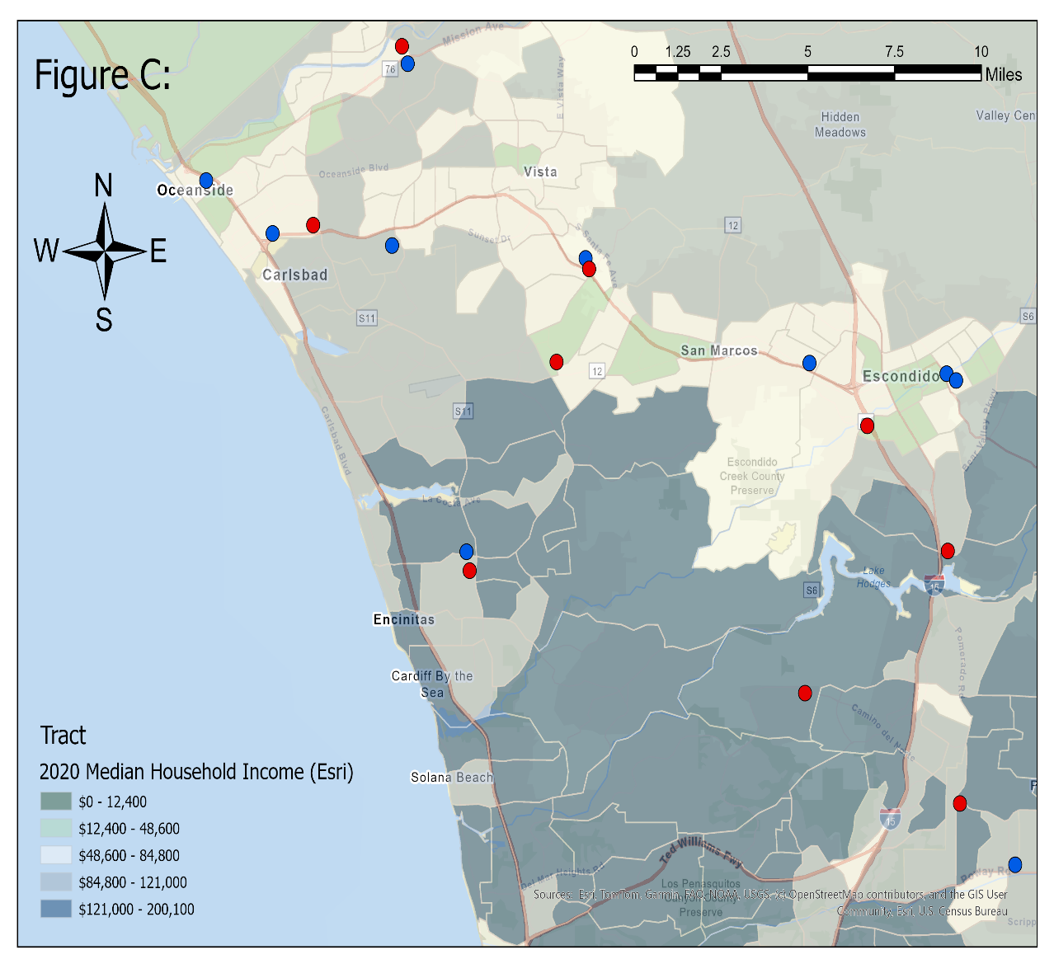
Median, Low-to-Moderate Income parts of North County SD
Figure B - Low to Moderate Income-Population by Block Group. (51% or more of the households earn less that 80 percent of the area median income, AMI.)
Figure C - 2020 USA Median Household Income split into 5 income levels.

Slide 4
Crimes to consider: How many classifications?
Final List of Crimes Committed (4)
Drugs/Alcohol
DUI
POSSESS CONTROLLED SUBSTANCE / PARAPHERNALIA / NARCOTICS
USE/UNDER THE INFLUENCE OF CONTROLLED SUBSTANCES
MINOR POSS ALC
TREATMENT-MANDATED FELONY HARD DRUGS W/2 PRIORS (F)
DISORDERLY CONDUCT (if referring to intoxication)
Violent Crime
SIMPLE BATTERY / BATTERY ON PERSON
BATTERY
COMMERCIAL ROBBERY
STREET ROBBERY
OTHER ROBBERY
SPOUSAL/COHABITANT ABUSE
ARSON
ASSAULT W/DEADLY WEAPON
THREATEN CRIME / EXECUTIVE OFFICER
EXHIBIT DEADLY WEAPON
CAUSE HARM/DEATH OF ELDER /DEPENDENT ADULT
WILFUL CRUELTY TO CHILD
STALKING
MURDER
RAPE
THROW SUBS AT VEH ON HWY
SHOOT AT INHABITED DWELLING/VEH (F)
BATTERY ON PERSON (if separate from above)
Theft/Fraud
PETTY THEFT
SHOPLIFTING
GRAND THEFT
COMMERCIAL/ RESIDENTIAL BURGLARY
VEHICLE BREAK-IN/THEFT
FRAUD
TAMPER WITH VEH
Misc. Crimes
VANDALISM
OTHER SEX CRIME
OBSTRUCT/RESIST EXECUTIVE OFFICER
PROHIBITED WEAPONS
PROHIBITED BY COURT ORDERS:PURCHASE/ETC FIREARM (F)
PROHIBITED PERSON OWN/POSSESS/ETC AMMUNITION/ETC (F)
STALKING (if non-violent)
PROSTITUTION
ANNOYING PHONE CALL
OBSTRUCT USE OF ANY WIRELESS COMMUNICATION DEVICE (M)
UNLAWFUL POSSESS/USE TEAR GAS OR TEAR GAS WEAPON:EX FEL/ETC (M)
Complete List of Crimes Committed (158)
PETTY THEFT(SHOPLIFT)
PETTY THEFT(Shoplift) (M)
PETTY THEFT(SHOPLIFT) (M)
PETTY THEFT(Shoplift)
PETTY THEFT (SHOPLIFT) W/2+ PRIOR CONVICTIONS (M)
PETTY THEFT(W/2 PRIOR CONVICTIONS) (F)
PETTY THEFT(All Other Larceny) (M)
PETTY THEFT(All Other Larceny)
PETTY THEFT(from Building) (M)
PETTY THEFT(Pocket Picking) (M)
…….
…….
PETTY THEFT(Purse Snatch) (M)
PETTY THEFT(Pocket Picking) (M)
PETTY THEFT FROM LIBRARY OR MERCHANT (M)
UNLAWFUL POSSESS/USE TEAR GAS OR TEAR GAS WEAPON:EX FEL/ETC (M)
PROHIBITED BY COURT ORDERS:PURCHASE/ETC FIREARM (F)
PROHIBITED PERSON OWN/POSSESS/ETC AMMUNITION/ETC (F)
SHOOT AT INHABITED DWELLING/VEH (F)
TREATMENT-MANDATED FELONY HARD DRUGS W/2 OR MORE PRIOR CONVICTIONS (F)
TREATMENT-MANDATED FELONY HARD DRUGS W/2 PRIORS (F)
TREATMENT-MANDATED FELONY HARD DRUGS W/2 PRIORS (F,
TREATMENT-MANDATED FELONY HARD DRUGS W/2 OR MORE PRIOR CONVICTIONS (F,
TREATMENT-MANDATED FELONY HARD DRUGS W/2 PRIORS (F
TREATMENT MANDATED FELONY ACT/MISD POSS W/ 2 PRIORS
How to condense 158 different crime descriptions down to the 4 most Important crime categories?
If done properly one uses R-Studio code.
(4) Crime Catagories
Drugs/Alcohol
Violent Crime
Theft/Fraud
Misc. Crimes

Slide 5
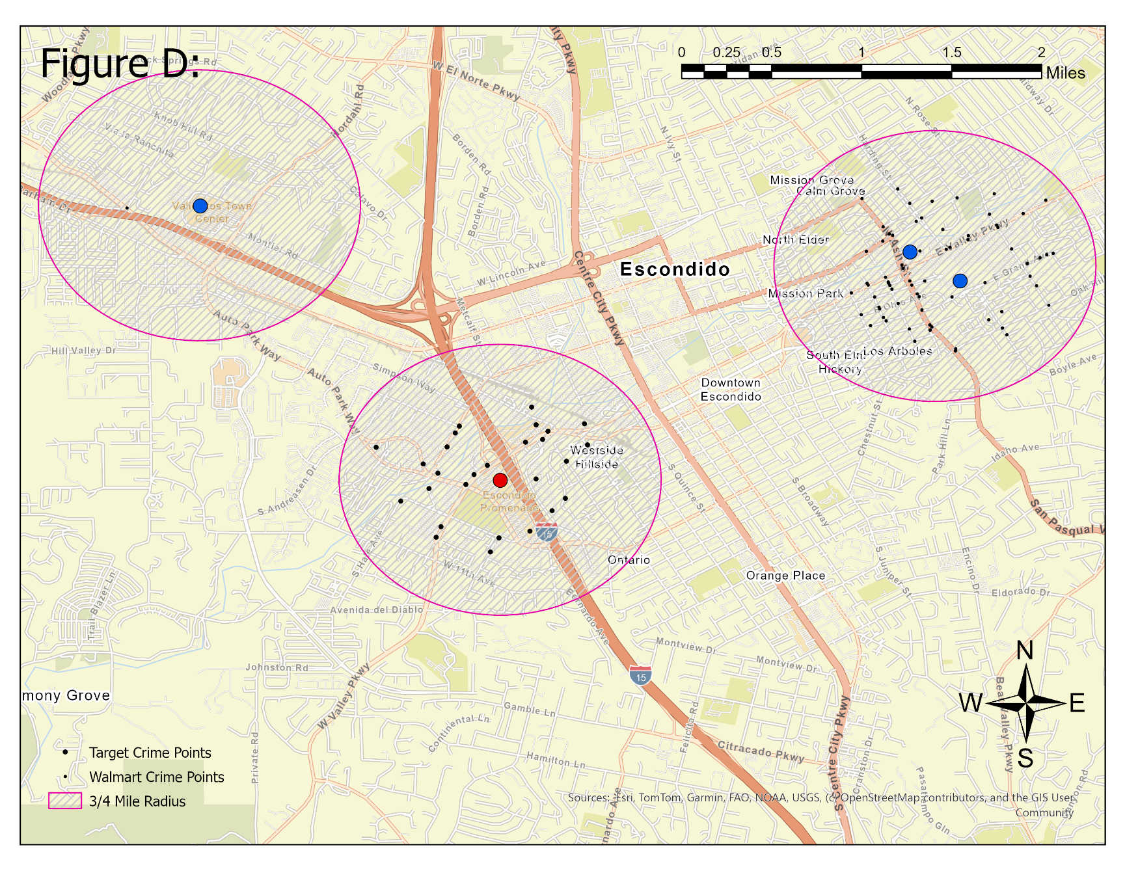
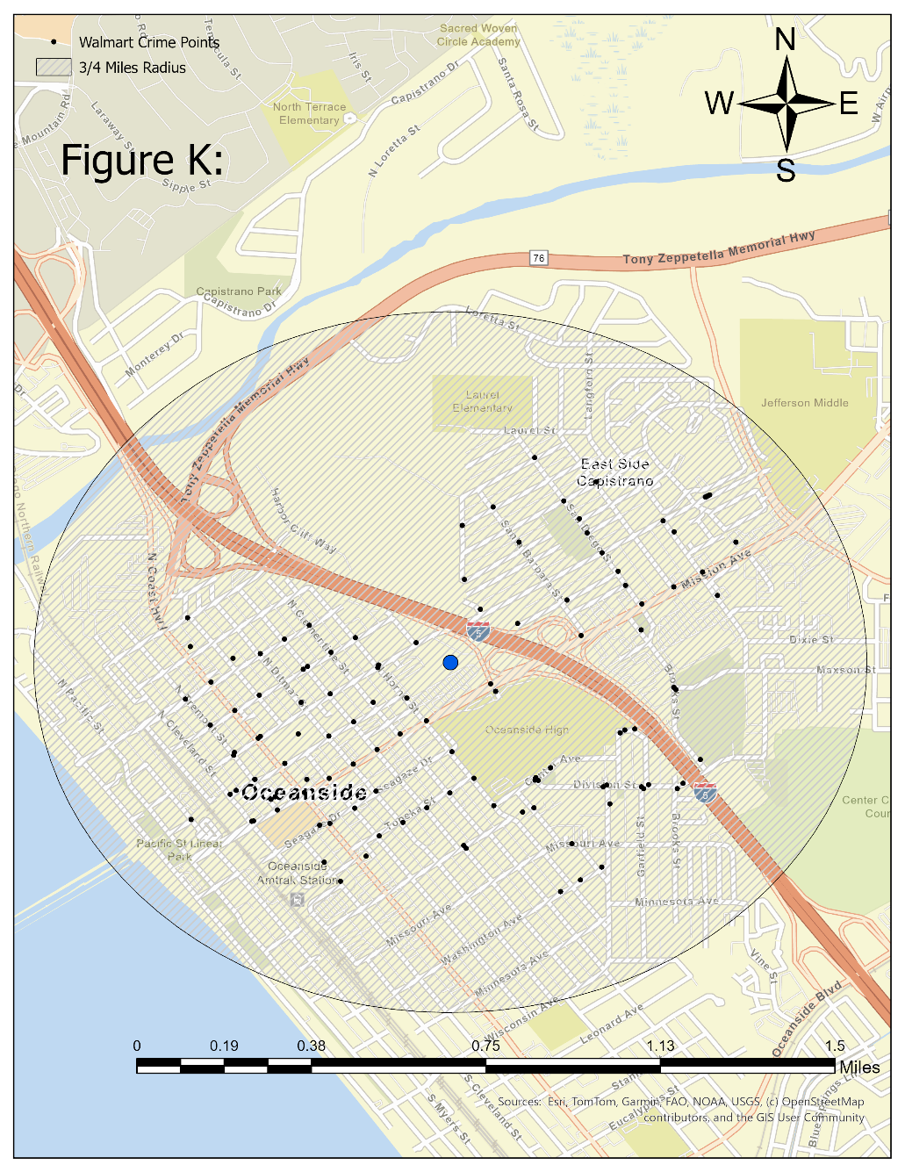
The Least safe Store Locations.

Slide 6
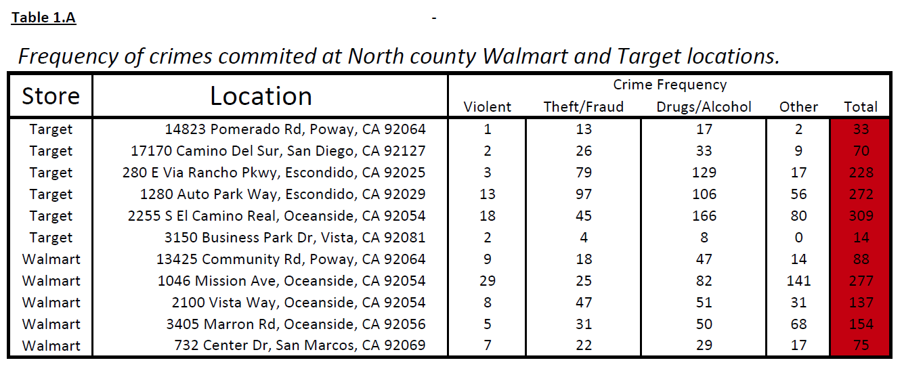
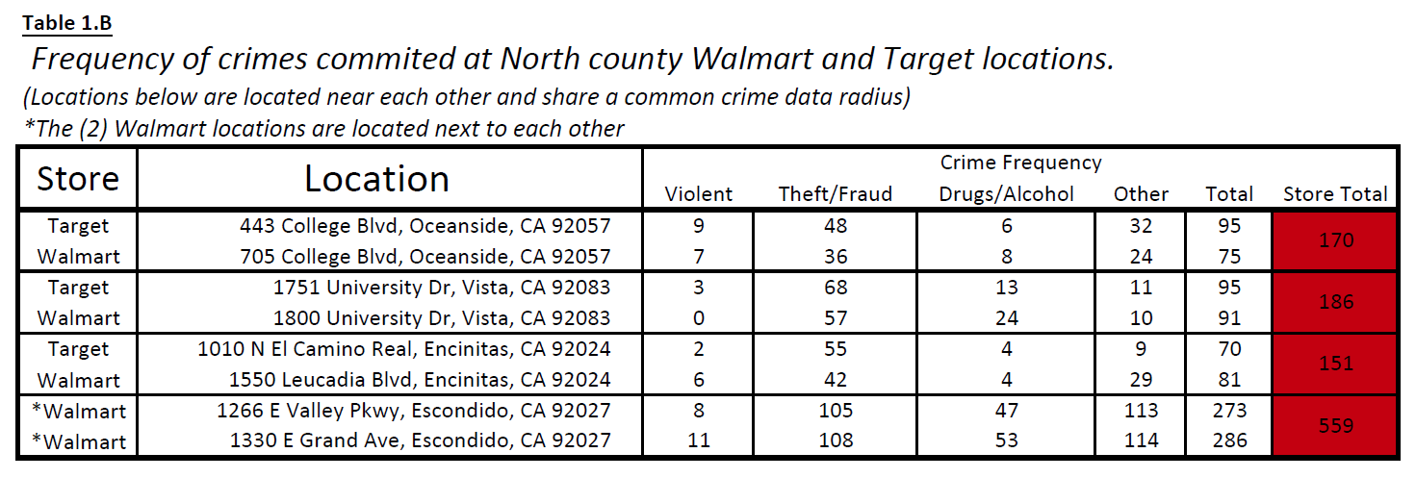
The Safest Store and Location.
The safest Store by far is a Target that’s located in Vista, CA near San Marcos HS.
It’s located at 3150 Business Park Dr. in the middle of a cluster of business parks.

